Slide 1
Probability Theory for Inference

Slide 2
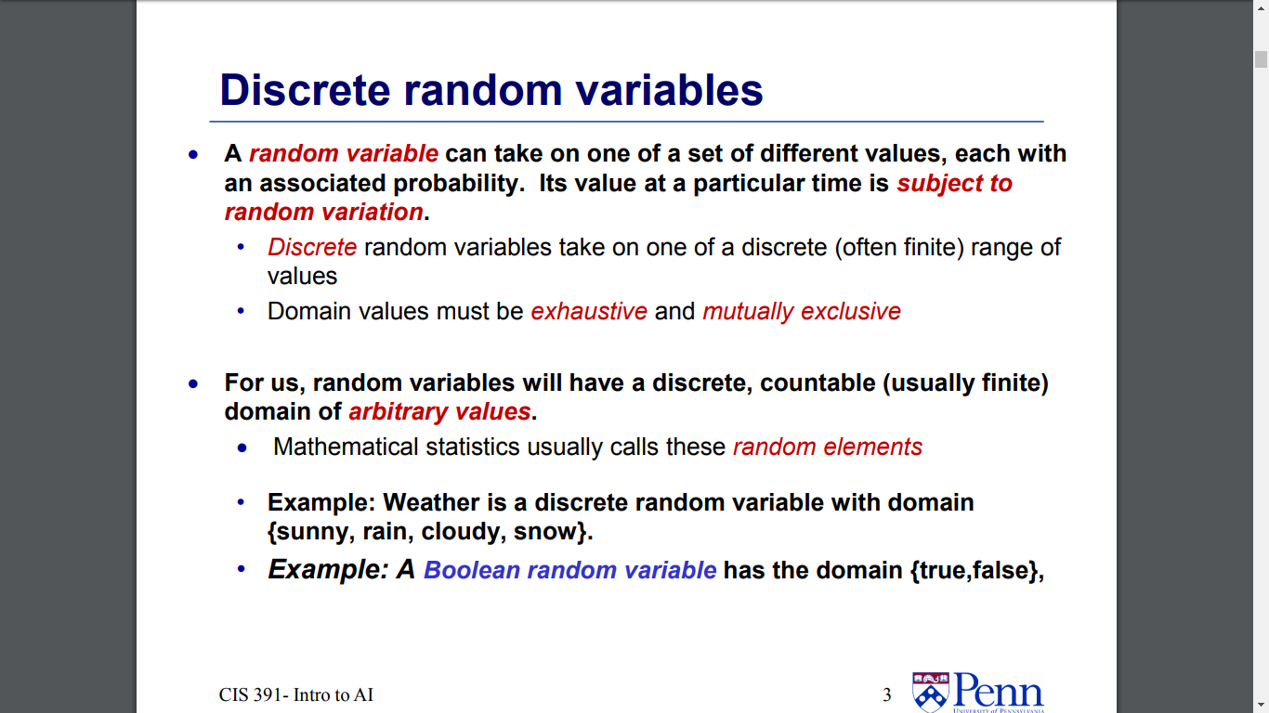

Slide 3
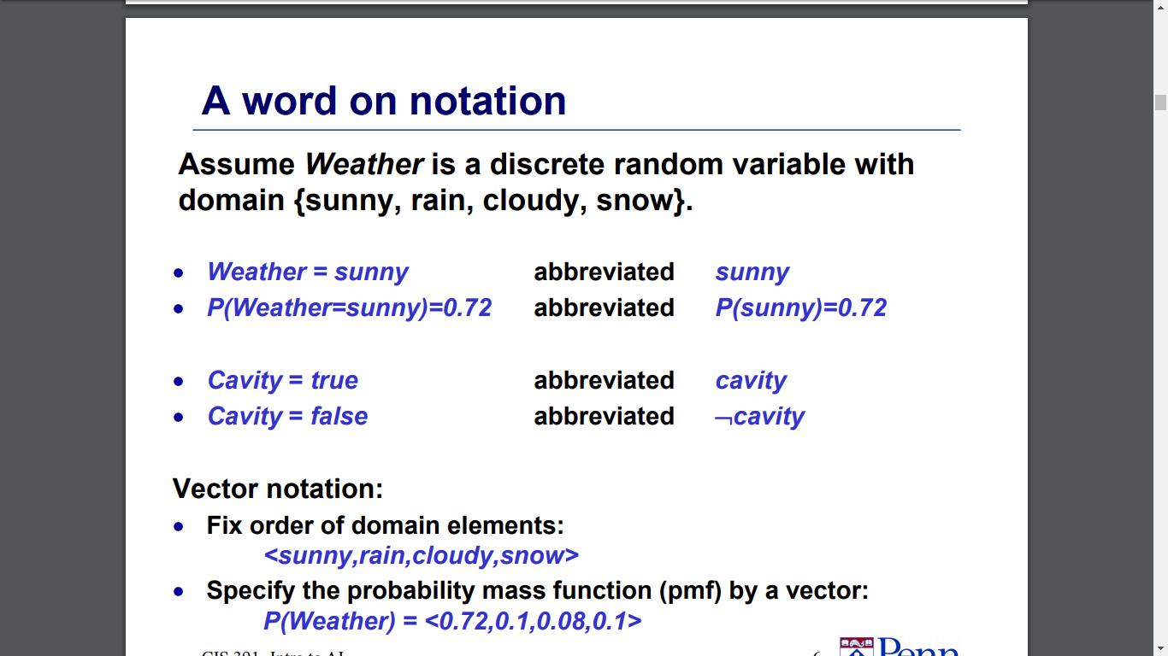

Slide 4
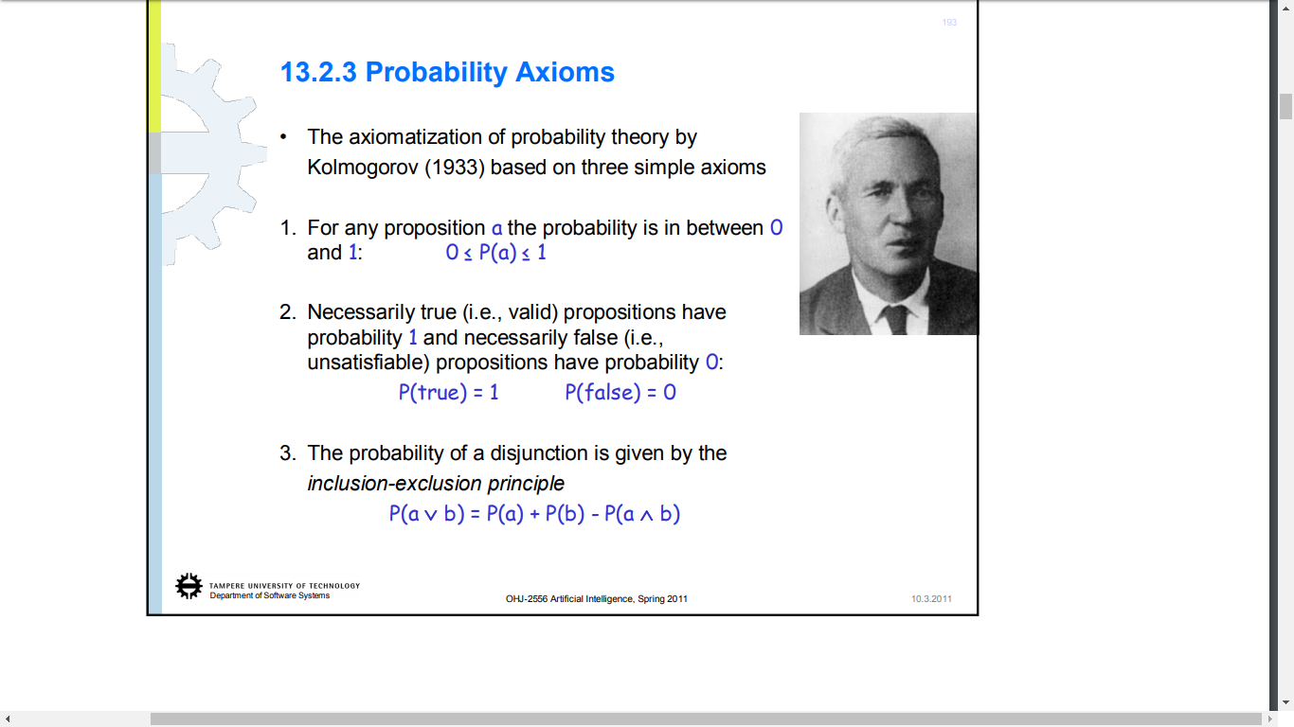

Slide 5
Probability Theory
Random variables
Domain
Atomic event: complete specification of state
Prior probability: degree of belief without any other evidence
Joint probability: matrix of combined probabilities of a set of variables
Alarm, Burglary, Earthquake
Boolean (like these), discrete, continuous
Alarm=True ∧ Burglary=True ∧ Earthquake=False alarm ∧ burglary ∧ ¬earthquake
P(Burglary) = .1
P(Alarm, Burglary) =
 | alarm | ¬alarm
burglary | .09 | .01
¬burglary | .1 | .8

Slide 6
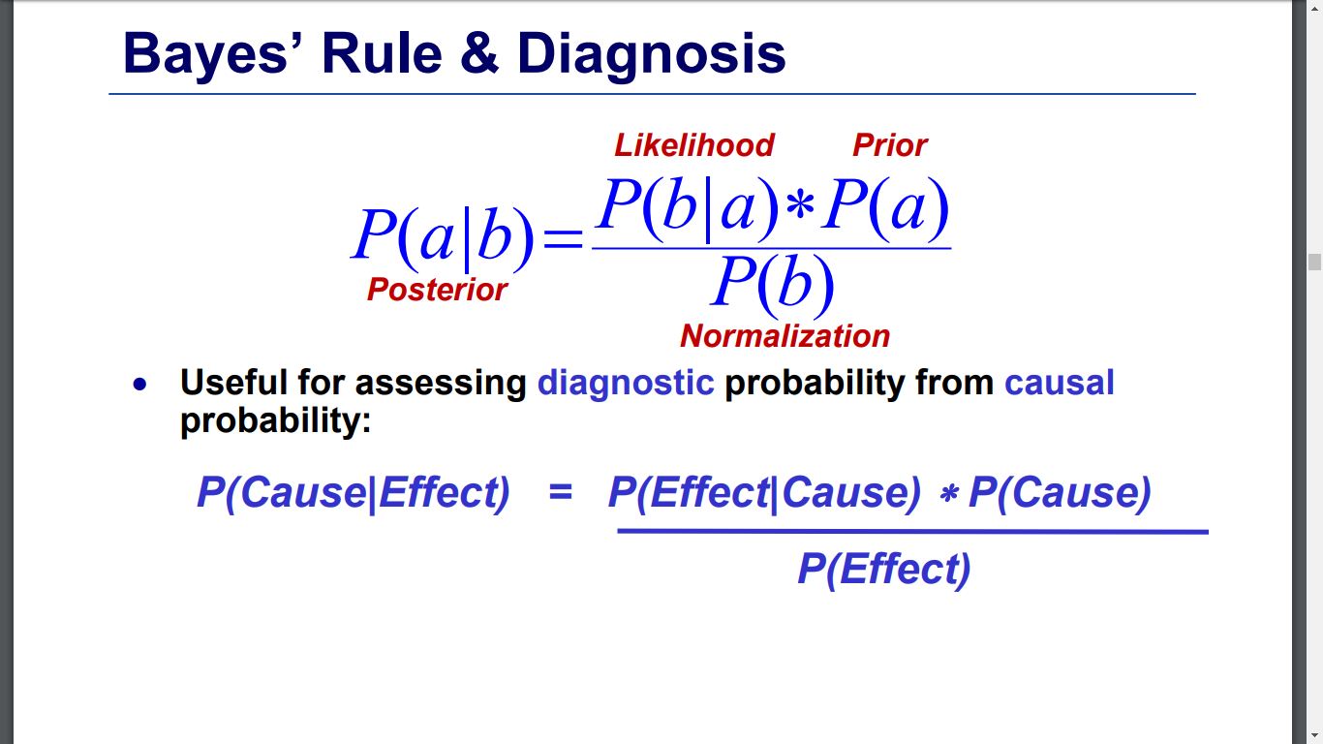
Probability Theory: Definitions
Computing conditional prob:
P(a | b) = P(a ∧ b) / P(b)
P(b): normalizing constant
Product rule:
P(a ∧ b) = P(a | b) P(b)
Marginalizing:
P(B) = Σ_{a}P(B, a)
P(B) = Σ_{a}P(B | a) P(a) (conditioning)

Slide 7
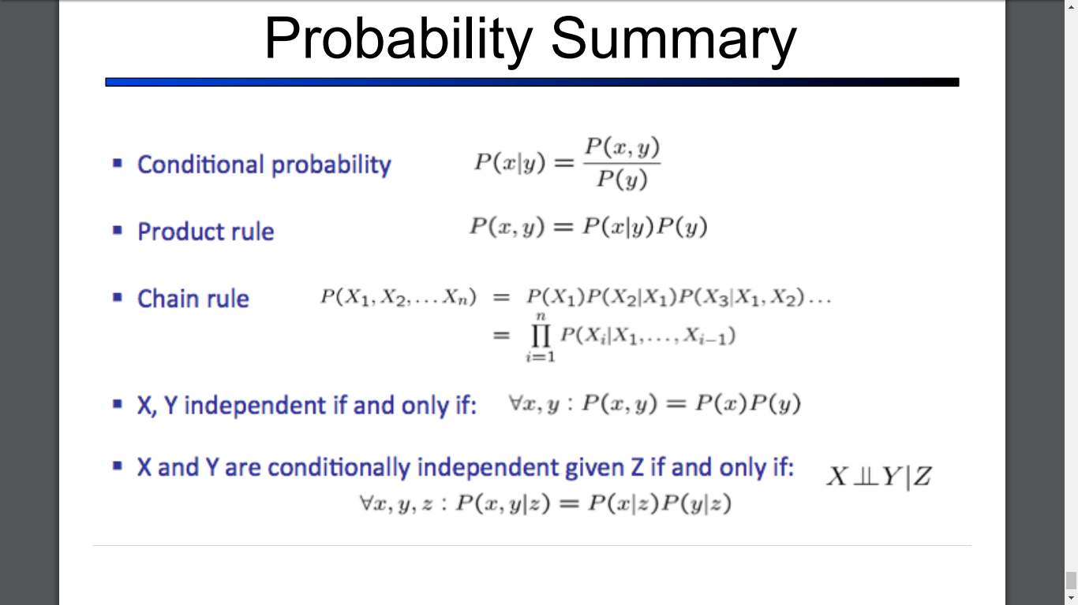

Slide 8
Try It...
 | alarm | ¬alarm
burglary | .09 | .01
¬burglary | .1 | .8
P(alarm | burglary) = ??
P(burglary | alarm) = ??
P(burglary ∧ alarm) = ??
P(alarm) = ??
Computing conditional prob:
P(a | b) = P(a ∧ b) / P(b)
P(b): normalizing constant
Product rule:
P(a ∧ b) = P(a | b) P(b)
Marginalizing:
P(B) = Σ_{a}P(B, a)
P(B) = Σ_{a}P(B | a) P(a) (conditioning)

Slide 9
Probability Theory (cont.)
Conditional probability: probability of effect given causes
Computing conditional probs:
P(a | b) = P(a ∧ b) / P(b)
P(b): normalizing constant
Product rule:
P(a ∧ b) = P(a | b) P(b)
Marginalizing:
P(B) = Σ_{a}P(B, a)
P(B) = Σ_{a}P(B | a) P(a) (conditioning)
P(burglary | alarm) = .47 P(alarm | burglary) = .9
P(burglary | alarm) = P(burglary ∧ alarm) / P(alarm) = .09 / .19 = .47
P(burglary ∧ alarm) = P(burglary | alarm) P(alarm) = .47 * .19 = .09
P(alarm) = P(alarm ∧ burglary) + P(alarm ∧ ¬burglary) = .09+.1 = .19

Slide 10
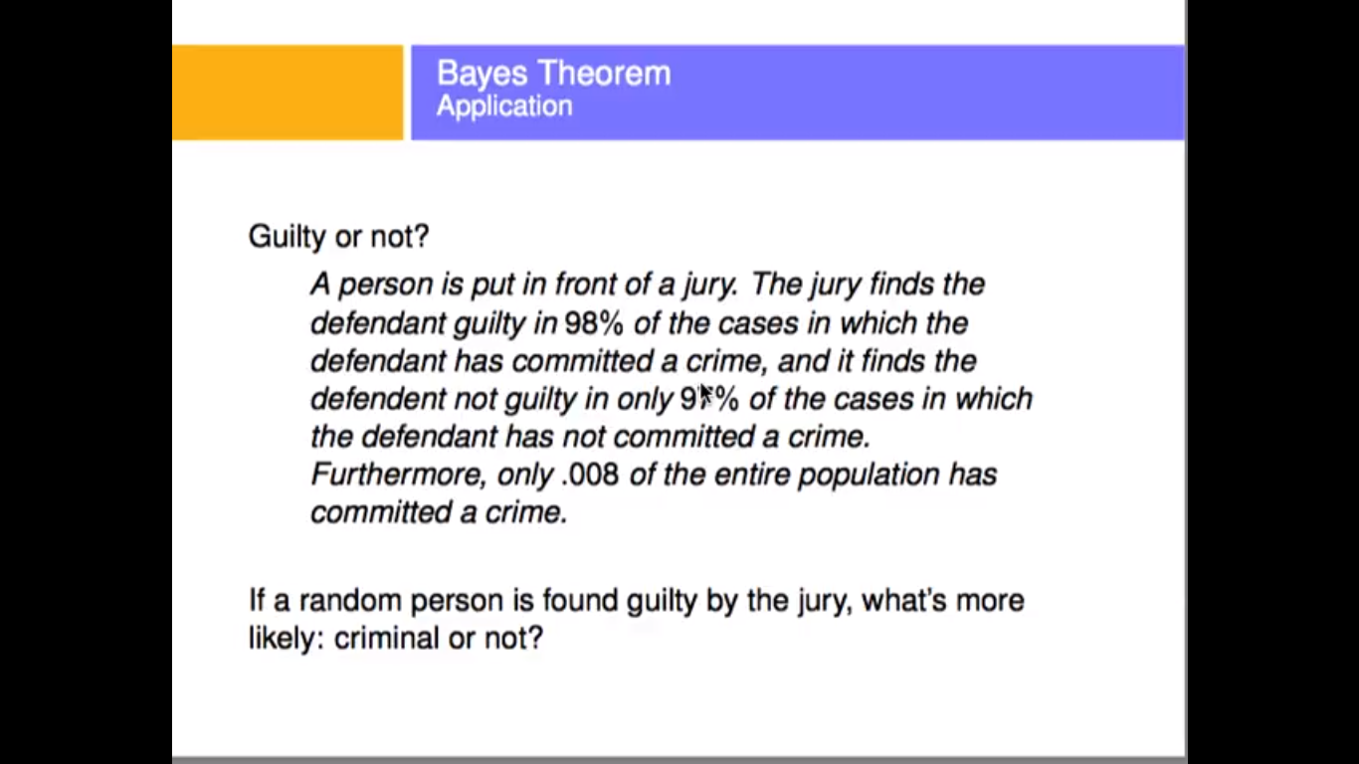

Slide 12
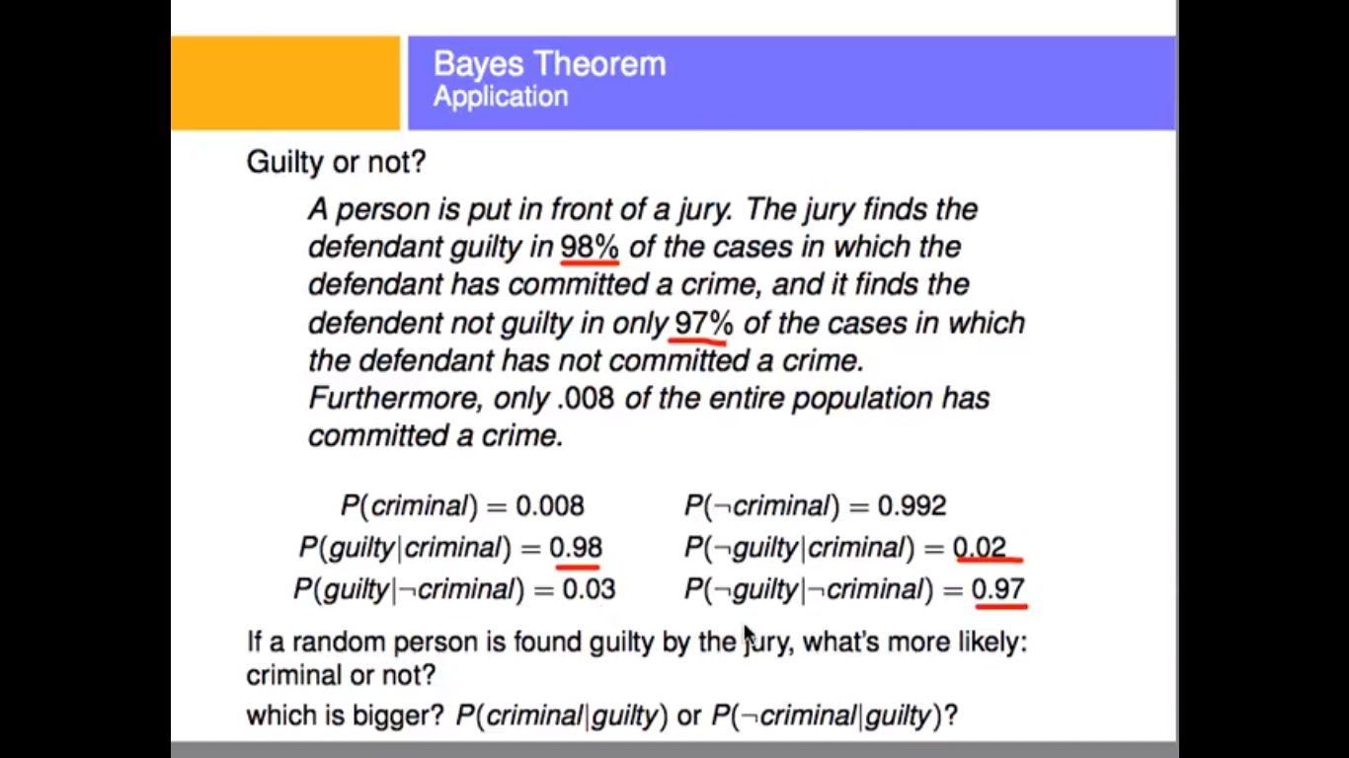

Slide 13
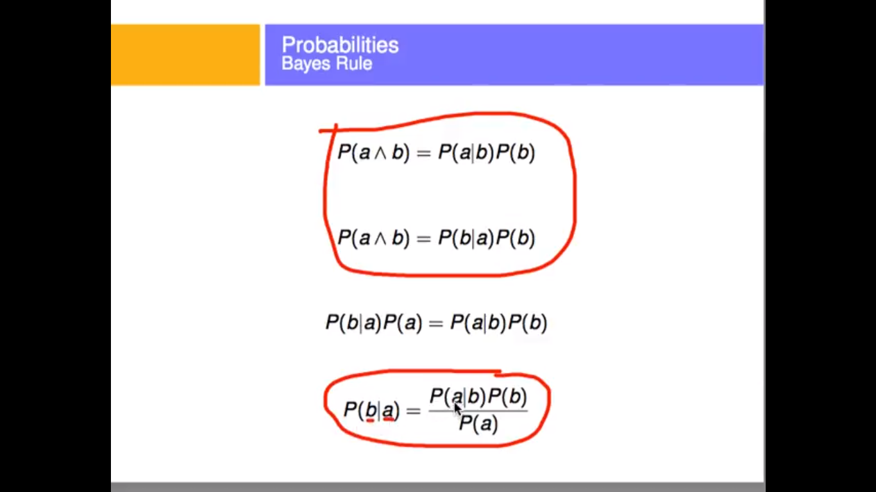

Slide 14
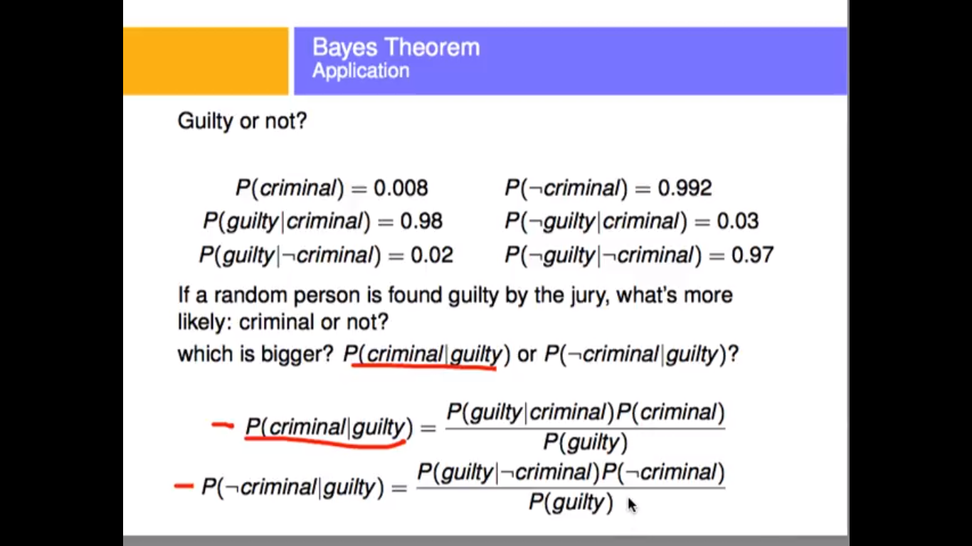

Slide 15
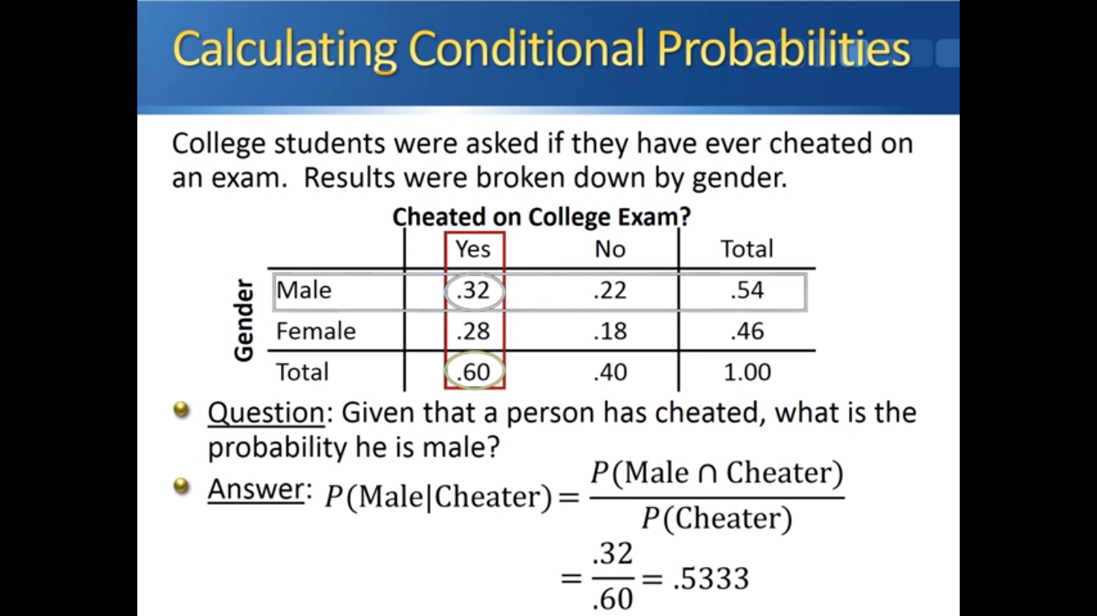

Slide 16
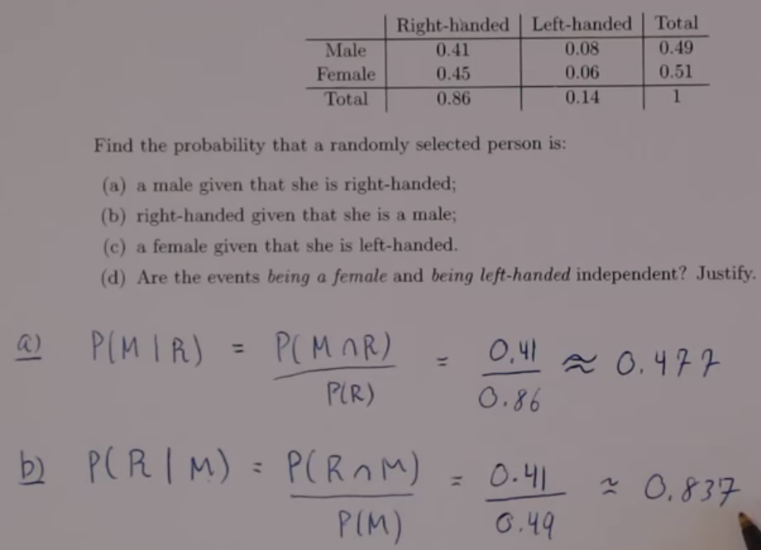

Slide 17
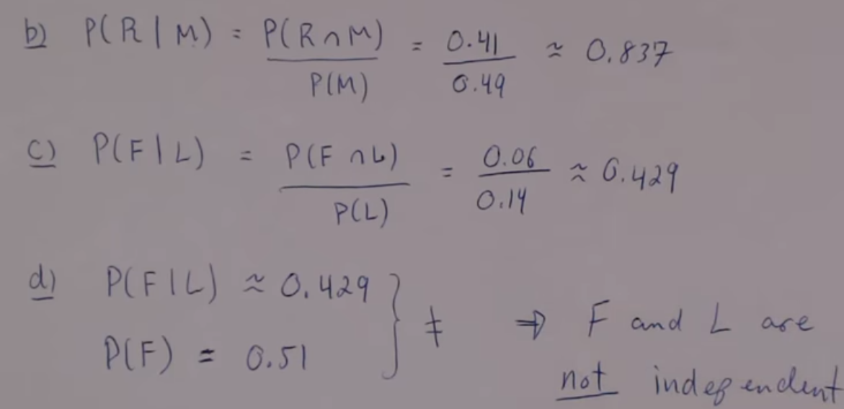

Slide 18
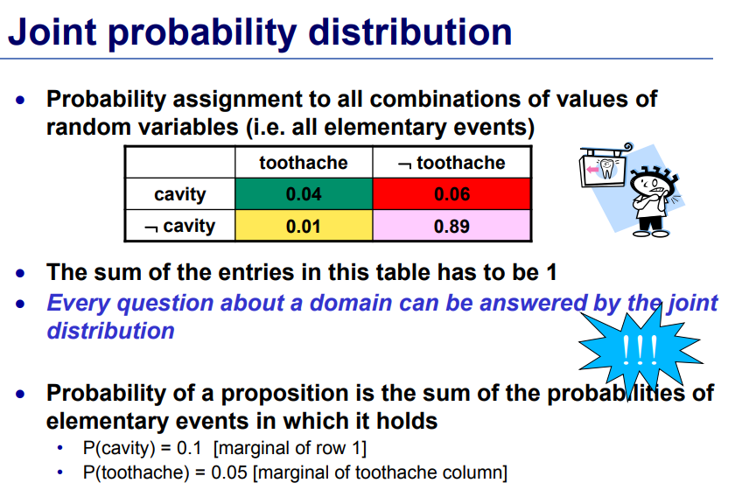

Slide 19
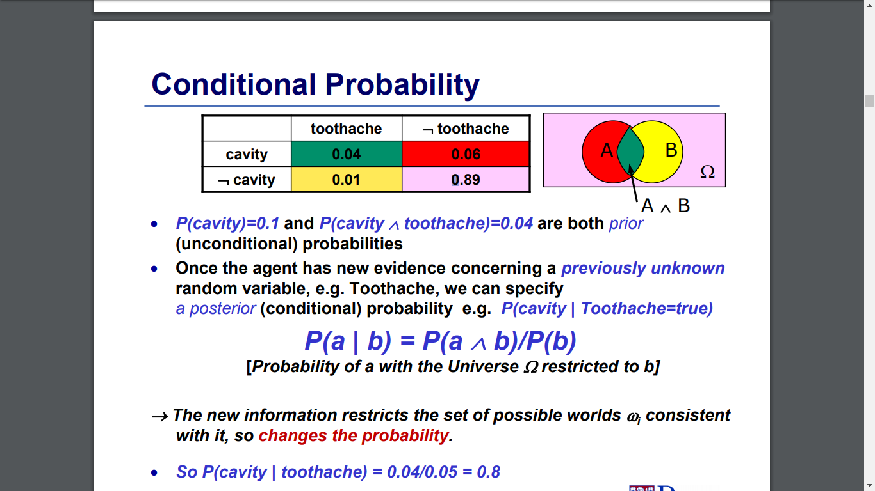

Slide 20
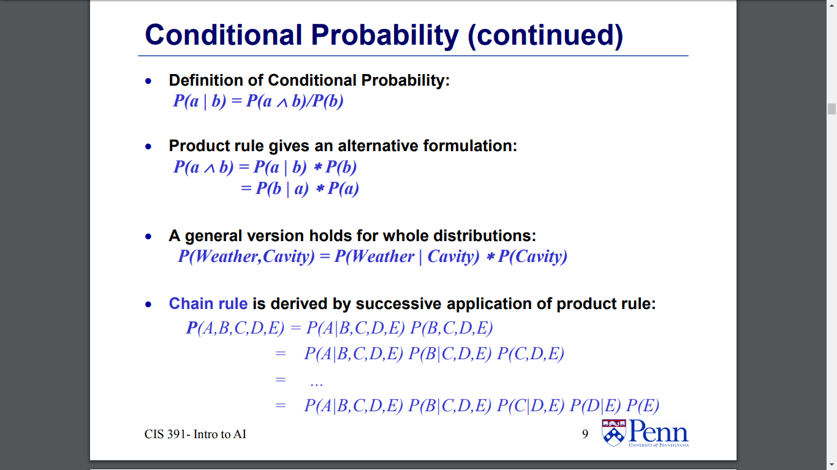

Slide 21
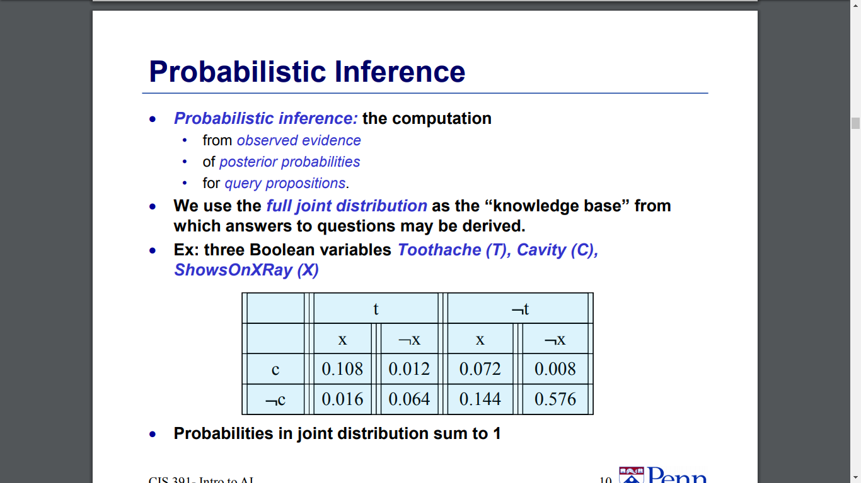

Slide 22
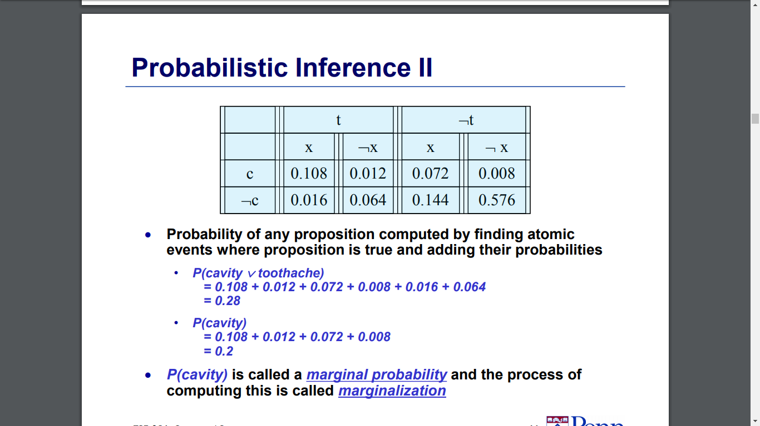

Slide 23
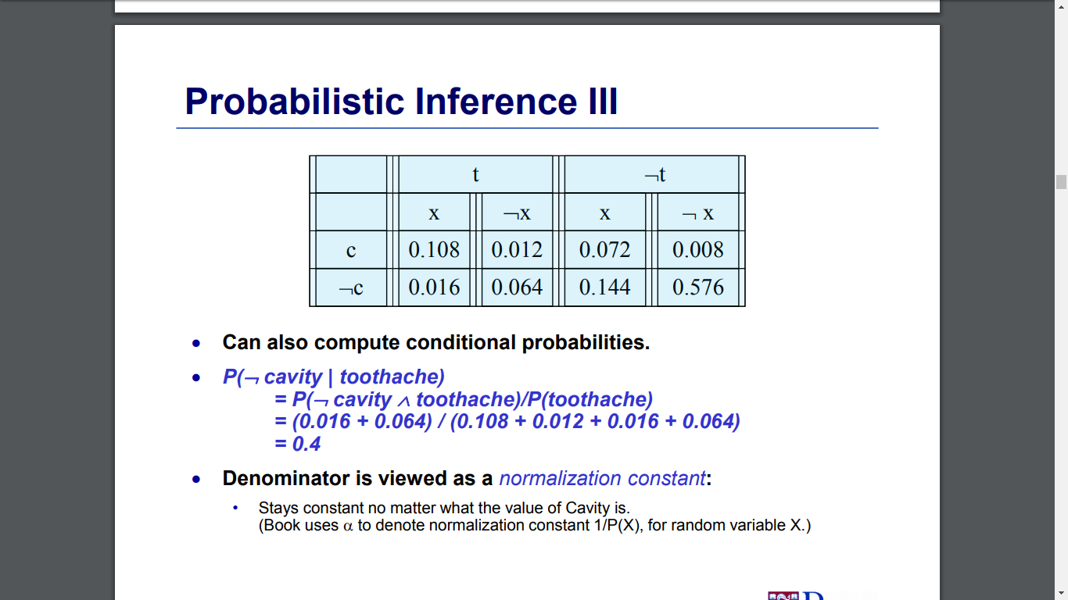

Slide 24
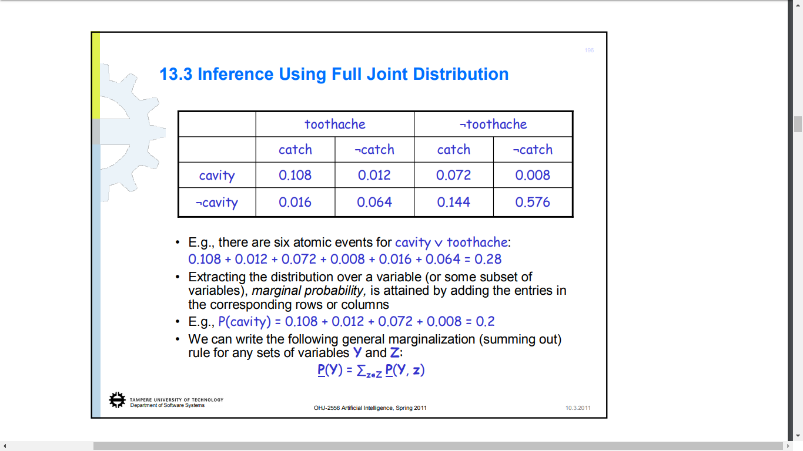

Slide 25
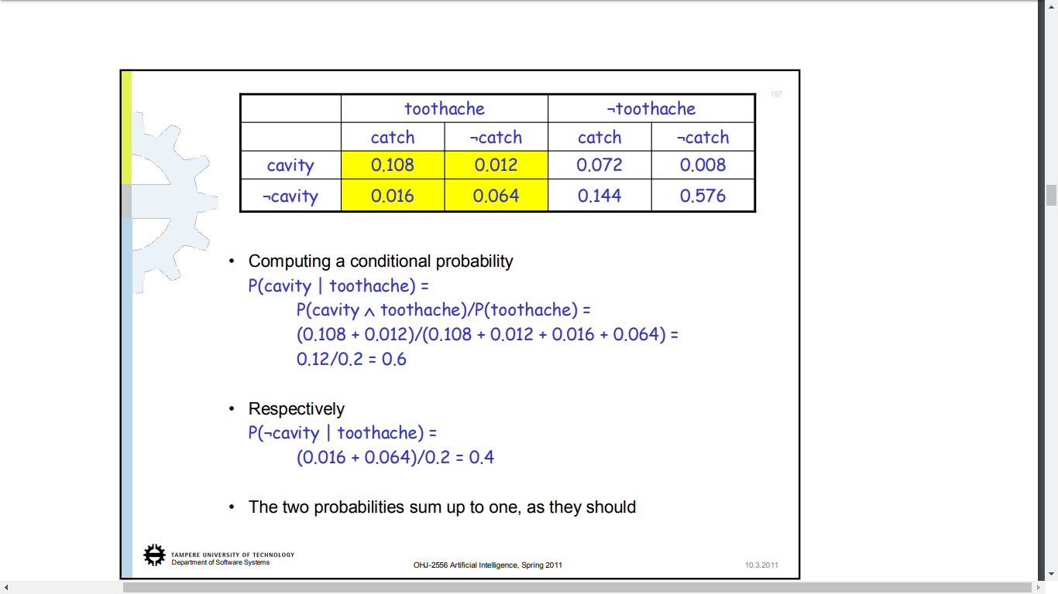

Slide 26
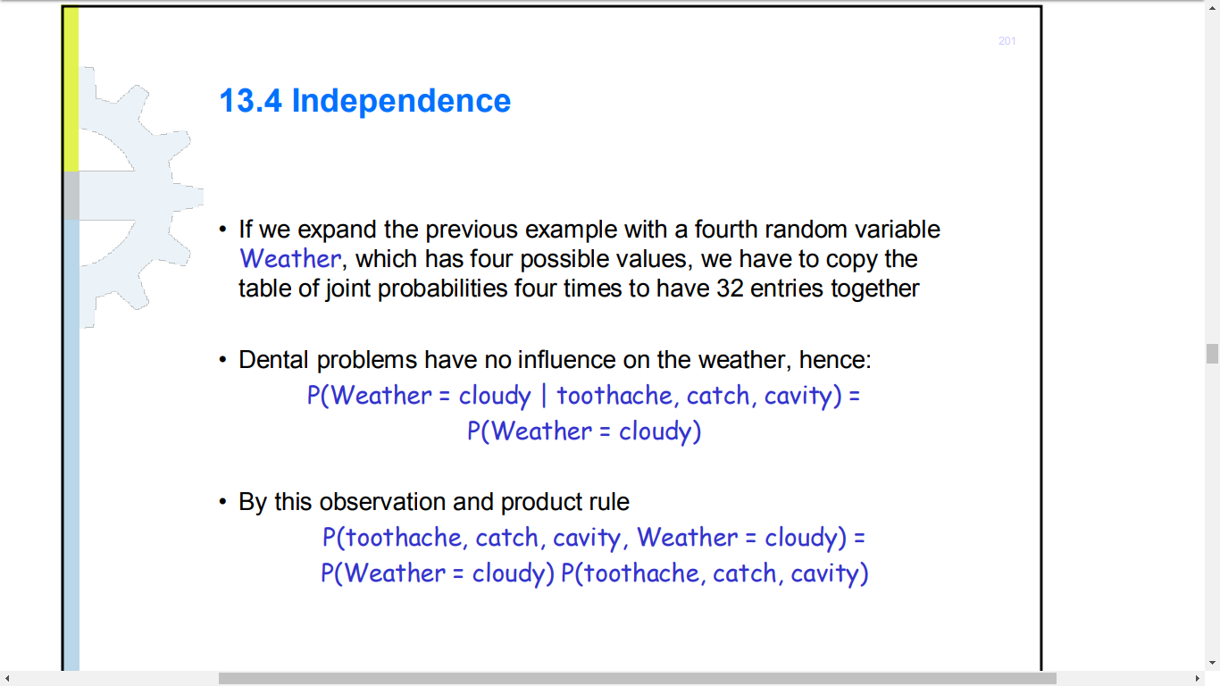

Slide 27
Conditional Independence
Absolute independence:
A and B are independent if P(A ∧ B) = P(A) P(B); equivalently, P(A) = P(A | B) and P(B) = P(B | A)
A and B are conditionally independent given C if
P(A ∧ B | C) = P(A | C) P(B | C)
This lets us decompose the joint distribution:
P(A ∧ B ∧ C) = P(A | C) P(B | C) P(C)
Moon-Phase and Burglary are conditionally independent given Light-Level
Conditional independence is weaker than absolute independence, but still useful in decomposing the full joint probability distribution

Slide 28
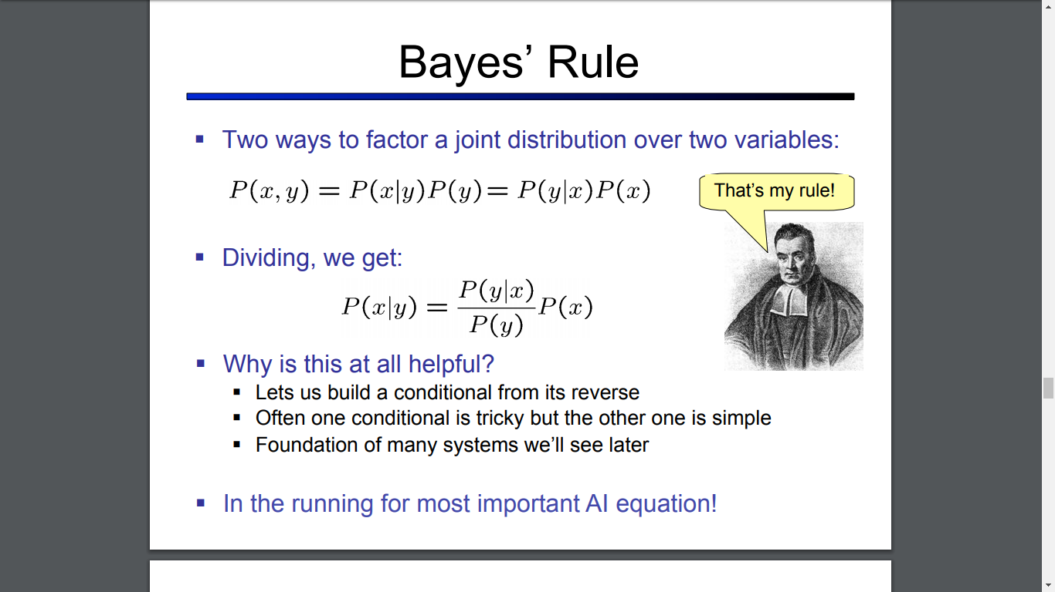

Slide 29
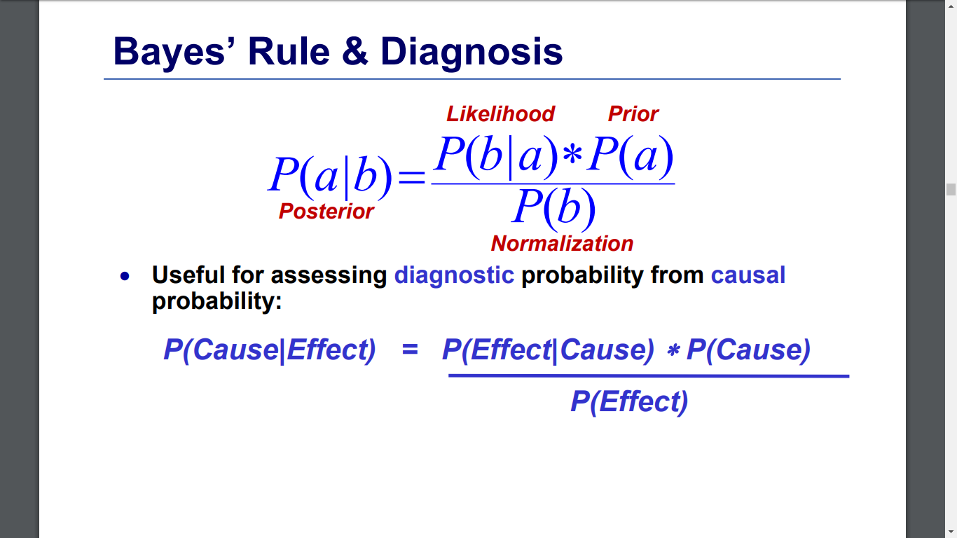

Slide 30
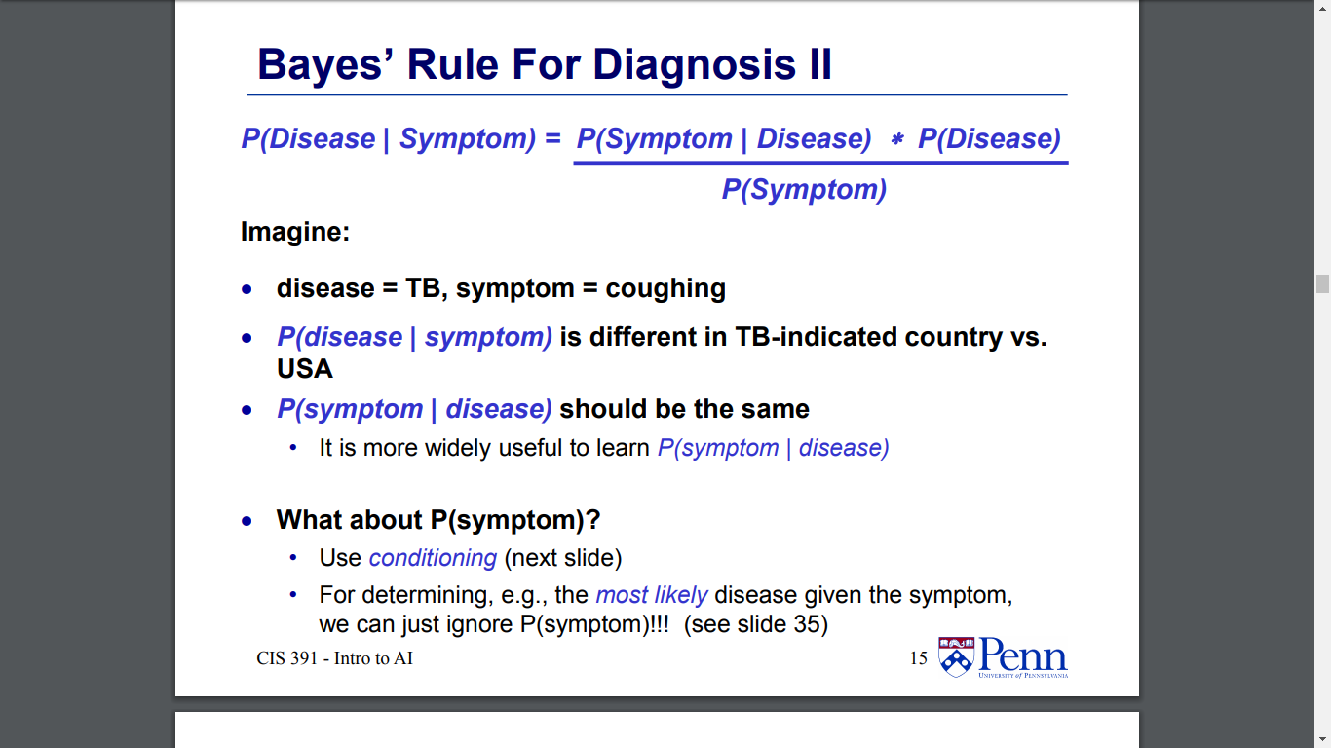

Slide 31
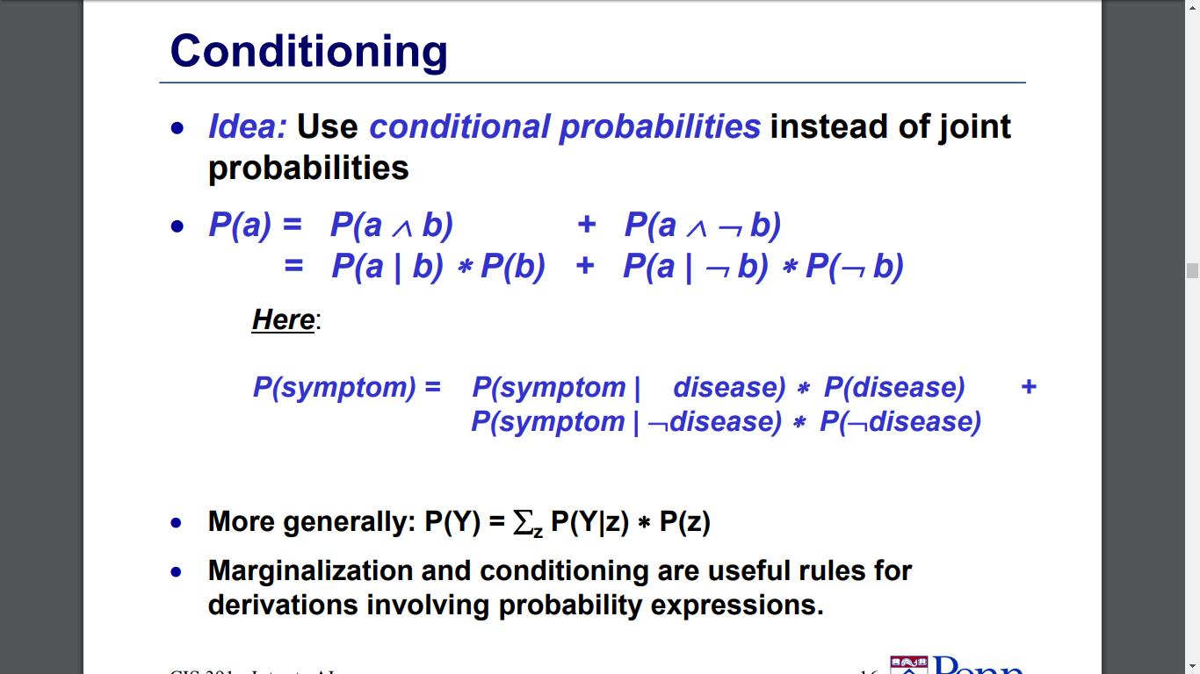

Slide 32
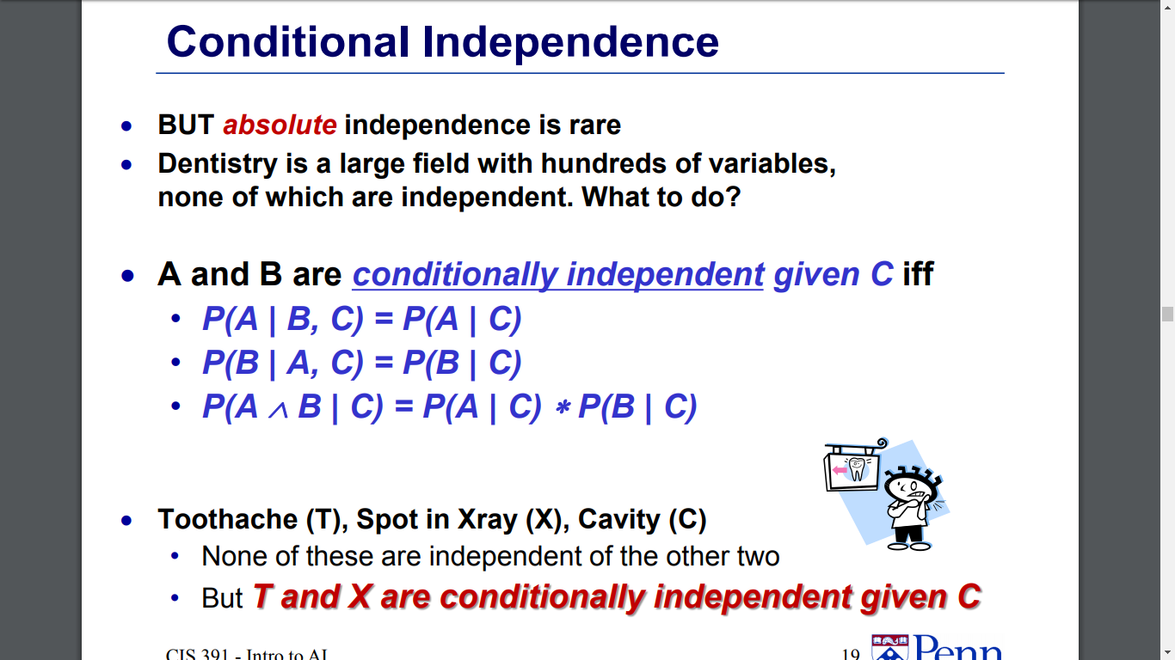

Slide 33
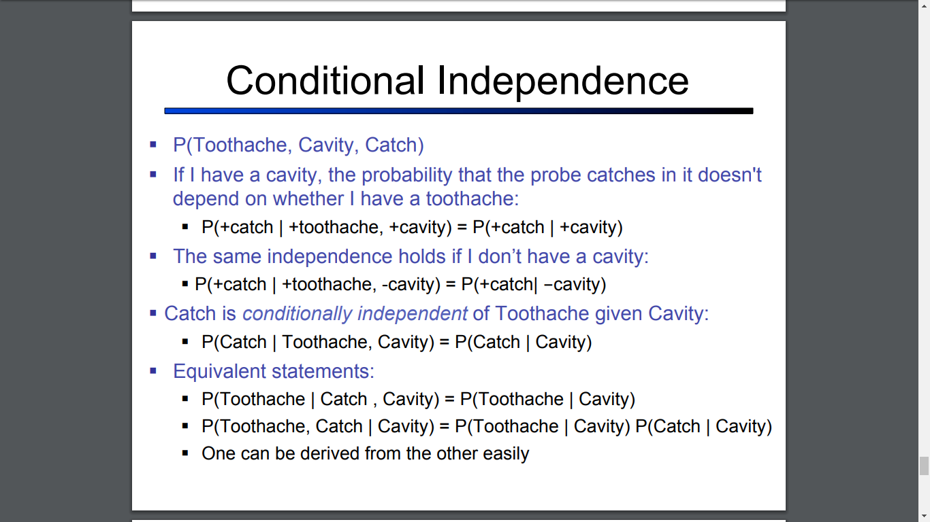

Slide 34
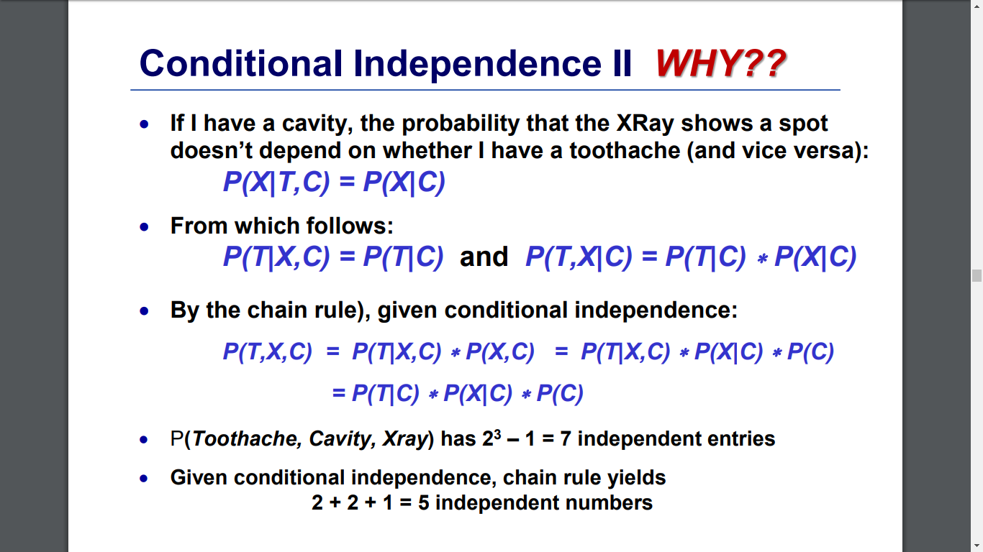

Slide 35
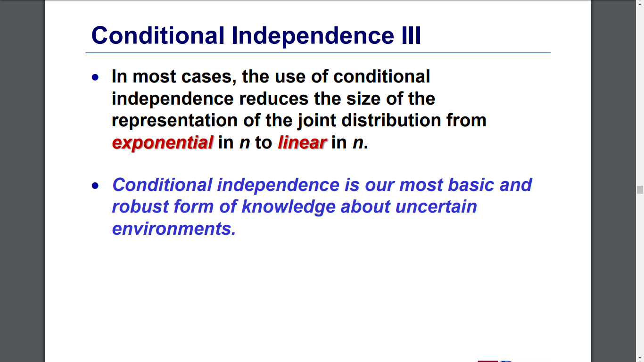

Slide 36
Exercise: Inference from the Joint
p(smart ∧ study ∧ prep) | smart |  | ¬smart
 | study | ¬study | study | ¬study
prepared | .432 | .16 | .084 | .008
¬prepared | .048 | .16 | .036 | .072
Queries:
What is the prior probability of smart?
What is the prior probability of study?
What is the conditional probability of prepared, given study and smart?
Save these answers for later! ☺

Slide 37
Exercise: Independence
p(smart ∧ study ∧ prep) | smart |  | ¬smart
 | study | ¬study | study | ¬study
prepared | .432 | .16 | .084 | .008
¬prepared | .048 | .16 | .036 | .072
Queries:
Is smart independent of study?
Is prepared independent of study?

Slide 38
Exercise: Conditional Independence
p(smart ∧ study ∧ prep) | smart |  | ¬smart
 | study | ¬study | study | ¬study
prepared | .432 | .16 | .084 | .008
¬prepared | .048 | .16 | .036 | .072
Queries:
Is smart conditionally independent of prepared, given study?
Is study conditionally independent of prepared, given smart?

